Slide 1
Balanced scorecard slide 1
Product Information form V6.0
Webinar Series - #1
Ingredient declaration (Section 2.1)
20 March 2020

Slide 2
Overview
Why is PIF V6.0 important for your Organisation?
Ingredient declaration (Section 2.1)
How it works in practice
AFGC Support for PIF V6.0

Slide 3
Balanced scorecard slide 2
AFGC PIF V6.0
Up to date regulatory content for compliance
Streamlines the process of recording and reporting product information
Information integrity
One true source
Searchable
Secure information access and sharing within a business
Use information for other applications
Why is PIF V6.0 important for your Organisation?
Notes:
PIF V6.0 has been designed to be a complete business solution
Up to date regulatory content for regulatory compliance – meeting all the legal obligations to comply with the Food Standards Code and other legislation
Streamlines the process of recording and reporting product information – business efficiency gains
Information integrity – management of information to help reduce errors and increase accuracy and currency of information
One true source – a trusted source of data available across the business and to key commercial partners
Searchable – increasing the value of the information to assist with business analytics
Secure information access and sharing within a business – state of the art crowd storage
Use information for other applications – IT standardisation to facilitate operations across the business.

Slide 4
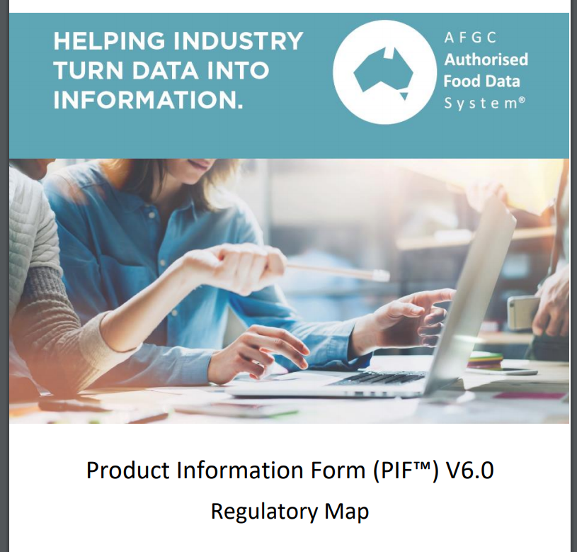
Balanced scorecard slide 2
AFGC PIF V6.0
Why is PIF V6.0 important for your Organisation?
Regulatory Compliance

Slide 5
Balanced scorecard slide 2
AFGC PIF V6.0
Why is PIF V6.0 important for your Organisation?
Regulatory Compliance
Document Control – PIF & Company
Section 1 - Company Information
Section 2 - Product Information
Country of Origin
Section 3 – Composition Information
VITAL & International Allergens
Section 4 – Foods Requiring Pre- Market Clearance
Section 5 – Nutrition Information
Section 6 – Claims

Slide 6
Balanced scorecard slide 2
AFGC PIF V6.0
Why is PIF V6.0 important for your Organisation?
Regulatory Compliance
Section 7 – Shelf life
Section 8 – Traceability
Section 9 – Measurement Marking
Section 10 – Potential Safety Hazards
Section 11 – Packaging
Section 12 – Specifications for Compliance
Section 13 – Company Specific Requirements
Section 14 – Extra comments & Attachments
Section 15 – Summary of Statements & Claims
Section 16 - Checklist

Slide 7
Balanced scorecard slide 2
AFGC PIF V6.0
Why is PIF V6.0 important for your Organisation?
Security
Security of PIF information is paramount and provided through:
Cloud storage
replaces paper files and/or in-house e-storage
sophisticated encryption
Access and approvals hierarchies with PIF – password controlled and audit logged
Owners/Administrators
Notes:
Security of information is a key feature of the new PIF 6.0 system. It is provided through:
Cloud storage. All PIFs are created and stored in the cloud. There is no need to download the PIFs into owner IT systems for storage (although this is possible). The cloud storage replaces the need of PIFs to be stored in hard copy or in-house as they are always accessible through the Vendor portals by authorised persons from any computer via the internet.
Cloud environment follows best industry practice to ensure IP protection and securely isolate each customer account.
PIF owners determine who in their organisations have authority to create PIFs, approve or sign-off PIFs, edit PIFs or have access on a read-only basis. They can also authorise individuals in commercials partners to access specific PIFs within the cloud.

Slide 8
Balanced scorecard slide 2
AFGC PIF V6.0
Why is PIF V6.0 important for your Organisation?
Security
Security of PIF information is paramount and provided through:
Controlled access for external commercial partners
Each PIF access and editing session tracked
Archive copies of PIFs maintained
Notes:
Security of information is a key feature of the new PIF 6.0 system. It is provided through:
The PIF system can monitor and record each access session – by whom, when and whether the PIF was edited.
If PIF is changed it will be stored as new version, but older versions are maintained in the Cloud this provides an additional levels of security of PIF information.

Slide 9
Balanced scorecard slide 2
AFGC PIF V6.0
PIF data entry is designed to be hassle free through portal functionality:
Draft & final status
Built-in user guidance:
hover text boxes
Link to the relevant section of the PIF User Guide
Pre-population of fields from master lists
Movement between sections of the PIF
Why is PIF V6.0 important for your Organisation?
Data Management
Notes:
PIF data entry is designed to be hassle free through portal functionality:
Built-in user guidance - “hover text boxes” provide guidance on data entry into specific parts of the PIF, and reference relevant sections of the PIF User Guide. Thus as users fill in or edit the PIF on-screen guidance and tips are provided to assist understanding. Reference to the User Guide allows users to rapid find additional information which can assist data entry and completion of the PIF.
Internal routines and tools provide checks of entered data to assist error-free entry and PIF completion. Data entry are linked within the PIF so that where the same information is required on more than one occasion it only needs to be entered once.
Sophisticated document control facilitates PIF management removing the chance of errors. This assists maintaining currency of PIF and that the correct version is used by the company. This is provided through features including
Each PIF having a unique identifier, and
Sophisticated version control during editing and archiving.

Slide 10
Balanced scorecard slide 2
AFGC PIF V6.0
Why is PIF V6.0 important for your Organisation?
Data Management
Error checking and validation, with on-screen feedback for users.
Built in comparison of current verses update PIF
Document control is provided through:
Each PIF has a unique identifier
Version control during editing and archiving
Amendment history
Approval process workflow
Notes:
PIF data entry is designed to be hassle free through portal functionality:
Sophisticated document control facilitates PIF management removing the chance of errors. This assists maintaining currency of PIF and that the correct version is used by the company. This is provided through features including
Each PIF having a unique identifier, and
Sophisticated version control during editing and archiving.

Slide 11
Balanced scorecard slide 2
AFGC PIF V6.0
Why is PIF V6.0 important for your Organisation?
IT
Built on industry standard approaches for data interchange, for example XML and SOAP (Simple Object Access Protocol)
PIF V6.0 has been designed to enable data exchange
IT specifications based on industry standard protocols
Interoperability with other commonly used data management systems for information upload and download.
Notes:
The PIF System has been built to allow comprehensive IT inter-operability allowing it to operate over the internet.
The PIF V6.0 has been designed with ease of data exchange paramount – there are specific IT specifications which are ‘unique’ to the PIF system.
All IT specifications use industry standard protocols -
Interoperability with other commonly used data management is assured, for information upload and download. This allows communication with other data bases and information management systems as well as providing download and upload from software programs such as MS Excel.

Slide 12
Balanced scorecard slide 2
AFGC PIF V6.0
Key steps to becoming a PIF V6.0 user:
Review the PIF V6.0 portals
Develop a transition plan
Upload existing company PIF v5
Input additional information
Send & receive PIFs
Manage data within the portal
Work with commercial partners to promote the use of the PIF V6.0 across product range
How it works in practice

Slide 13
Balanced scorecard slide 2
AFGC PIF V6.0
AFGC Biscuit Co
PIF V6.0 Portal
PIF V6.0
Create or receive
Internal database
Customer PIF V.6 portal(s)
Existing PIF v5
[internal & External]
PIF Exchange:
Your choice
You control
Multiple Recipients
Some or all information
YOU choose
External database

Slide 14
Balanced scorecard slide 2
Roles & Responsibilities
AFGC
Data Dictionary
Functional Specification
User Guide
Other Supporting documents
Training
PIF support
Vendors
Adhere to Data Dictionary and Functional Specification
Portals
Portal to portal communication
Portal User Support

Slide 15
Balanced scorecard slide 2
AFGC PIF V6.0
AFGC Support for PIF V6.0
PIF V6.0 Support materials:
User Guide
Regulatory Map
Q&A
Webinar
Email & phone support
PIF Implementation Group:
Exchange information
Provide advice on improvements
Agree on priorities
Promote use and benefits of PIF V6.0
Notes:
The AFGC is committed to providing on-going support of the PIF V6.0 system. This will comprise:
Support material updates
The user guides, fact sheets and Q&A sheets will be updated as the PIFV6.0 system is upgraded.
Email and phone support
A PIF implementation group. Individuals from companies using the system will be invited to join the group. Their role will be to:
Exchange helpful information about how to implement and work with the PIF V6.0 system
Provide advice to the AFGC on how the system might be improved in its scope, functionality and features
Agree on priorities for future upgrades including identifying issues which might be urgent
Promote the benefits of the PIF System and encourage its use.

Slide 16
Balanced scorecard slide 2
AFGC PIF V6.0
Periodic updates
Based on user feedback and change requests
Workshops and training
Vendor Technical Group
Exchange Information
Implement agreed changes to functionality
Technical solutions
AFGC Support for PIF V6.0
Notes:
The AFGC is committed to providing on-going support of the PIF V6.0 system. This will comprise:
Periodic updates
Based on input from the Users and Vendor groups the PIF V6.0 will be subject to periodic upgrades.
Workshops and training
The AFGC will continue to provide training for new and existing users of the PIF V6.0 system.
A Vendor Technical Group which will provide a forum for:
Exchange information on technical aspects of the system
Implement agreed changes to the functionality of the system and engage in testing to ensure smooth implementation
Agree on technical solutions to upgrades or trouble shooting.

Slide 17
Balanced scorecard slide 10
PIF V6.0 Support
Website
Email

